Slide 1
IIT Maze game
By Harshit mawandia(2020CS10358) and
nirbhay kumar(2020CS10365)

Slide 2
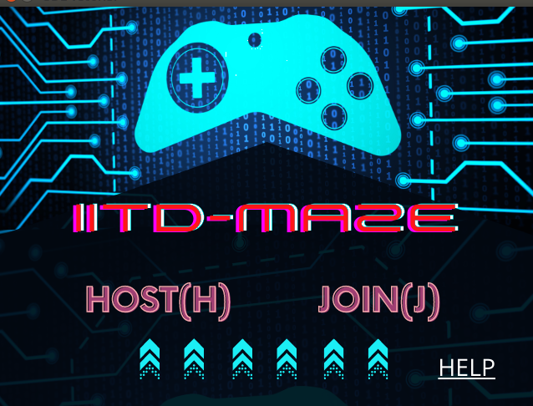
Start screen
Two players must be connected to the same network.
One player must host the game first, by pressing H key.
The other player can join the game by pressing J key.
The game begins after J key is pressed.

Slide 3
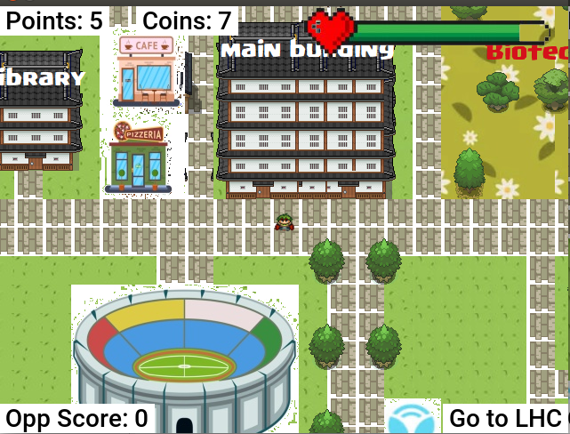
Game begins
Points: (Top left corner) Each player gets 5 points when a task is completed. A player wins when he reaches to 30 points
Coins: (Top)Each player earns certain number of coins during tasks which he can spend on riding yulus.
Tasks: (Bottom right corner) Complete these in order to win.
Opponent score: (Bottom left) So you get the idea of how close the opponent is to winning.
Health Bar: (Top right) shows health status. This is constantly decreasing with time

Slide 4
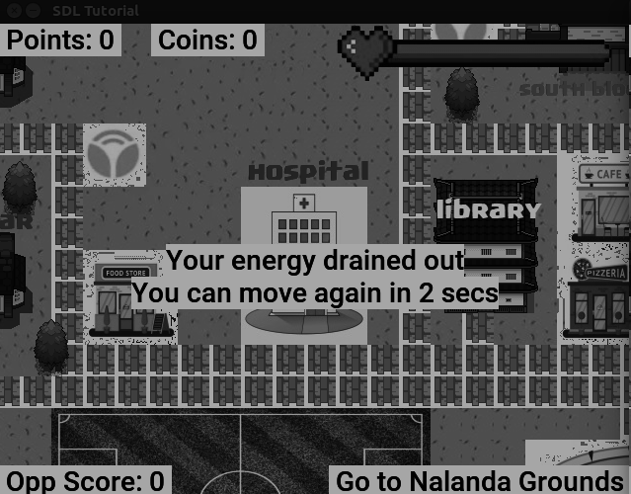
Health depleted
You are sent to the hospital when your health depletes completely.
A 20 second penalty is given. You can move after this time only
You are respawned at the hospital

Slide 5
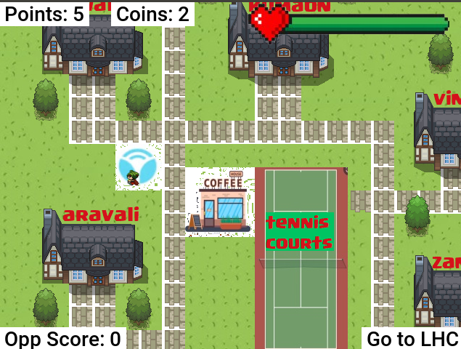
YULU
Go on a yulu zone to triple your speed for certain amount of time.
Riding a yulu costs 5 coins

Slide 6
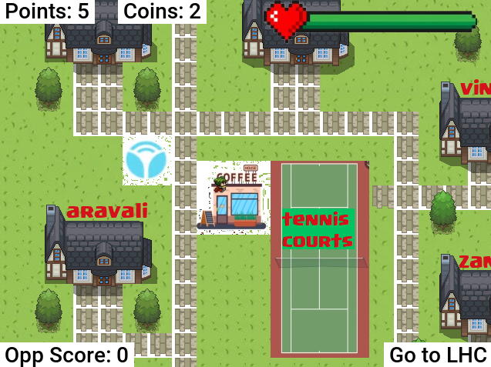
Eateries
There are numerous eateries present across campus
Go to an eatery to replenish your health.

Slide 7
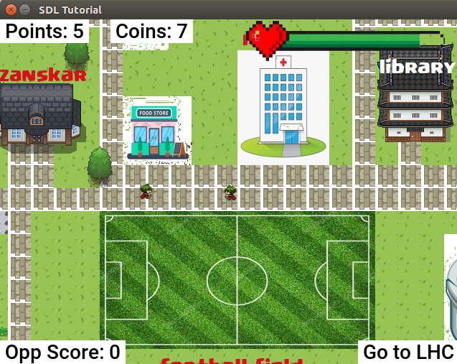
Two player functionality
Both players can see each others sprite in their map.
Opponent score is also visible so that one gets an idea of how close the opponent is to victory.

Slide 8
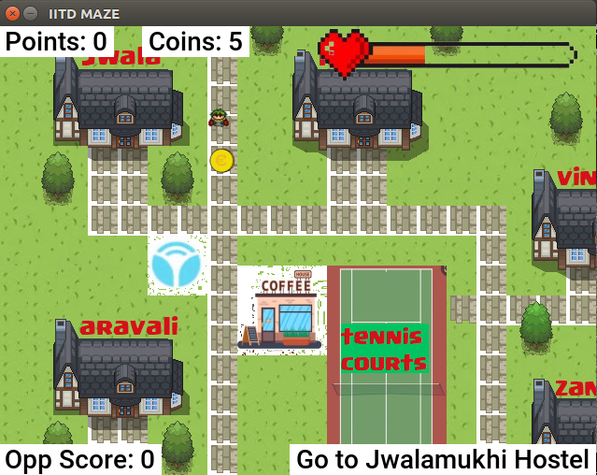
Scattered coins
Coins are scattered across the map
Collect them to increase your coins

Slide 9
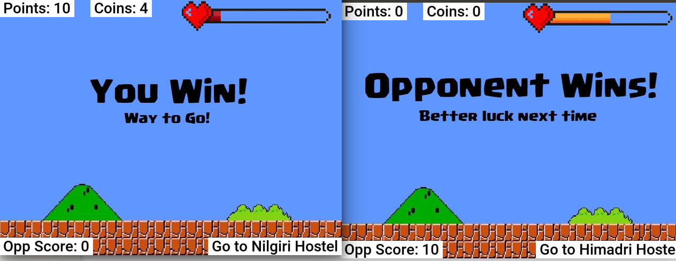
End screens
The above screens are displayed when you win or opponent wins, respectively.
This happens when you reach a score of 30. (10 for the demo)

